Slide 1
Stock Market Data analysis
Group No. 1
Team Members
1.Mr.Gourang Bongale
2.Ms.Tasmiya Mohammadi
3.Mr.Suraj Manchekar
4.Mr.Ajay Bhalekar
5.Ms.Payal Soni
6.Mrs.Prachi Vinchu
7.Mr.Jayanth S

Slide 2

Objective
Provide insights into the stock market performance of major companies.
Identify patterns, trends, and anomalies in stock behavior over time.
Make informed decisions regarding stock purchases.
Make informed decisions regarding stock sales.
Make informed decisions regarding stock holdings.

Slide 3

Kpi’s in Dashboard
1.Average Daily Trading Volume
Observation :- This means that, on Average,5.51 million shares of the stocks are traded each day .This is a relatively high trading volume, which indicates that there is a lot of interest in the stocks from both Buyers and Sellers. This can be seen as a positive sign, as it suggests that the stock is liquid and that it will be relatively easy to buy and sells shares.

Slide 4
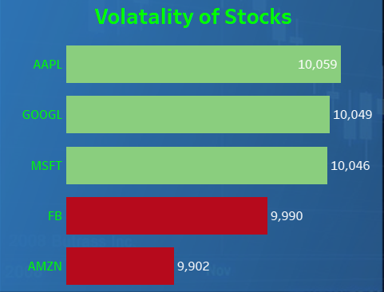
2.Volitality of Stocks
Observation :- Volatility is a measure of how much a stock’s price fluctuates over time. The graph on this slide shows the volatility of five different stocks: AAPL, GOOGL, MSFT, FB, and AMZN.
The green lines represent the most volatile stocks, while the red lines represent the least volatile stocks. As you can see, AAPL is the most volatile stock, followed by GOOGL and MSFT. FB and AMZN are the least volatile stocks.
Conclusion :- Stock volatility has implications for investors. Volatile stocks may be more risky to invest in, but they may also offer the potential for higher returns. Investors should carefully consider their risk tolerance and investment goals before investing in volatile stocks.

Slide 5
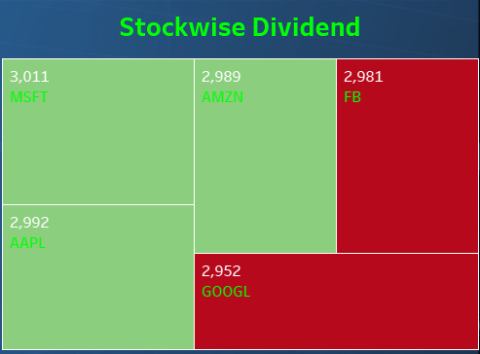
3.Stock Wise Dividend
Observation :-The Graph shows a stock wise dividend chart, which compares the dividends paid by five different companies: Microsoft (MSFT), Amazon (AMZN), Facebook (FB), Apple (AAPL), and Alphabet (GOOGL).
The chart shows that MSFT pays the highest dividend, followed by AMZN, FB, AAPL, and GOOGL.
The chart also shows that the difference in dividends paid by the different companies is relatively small. For example, the difference between the dividend paid by MSFT and the dividend paid by GOOGL is only about $50.
Conclusion :-Dividend payments can have a number of implications for investors. For example, dividend-paying stocks can provide a steady stream of income for investors. Dividend payments can also help to reduce the overall volatility of an investment portfolio.
Investors should carefully consider their investment goals and risk tolerance before investing in dividend-paying stocks.

Slide 6
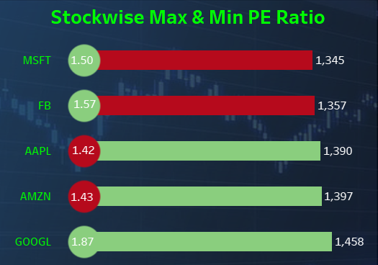
4.Stock Wise Min & Max PE Ratio
Observation :- The Graph shows a Stock wise Max and min PE Ratio, Where Bar chart represents the Max PE Ratio of stocks & Circles are represents the Min Ratio of Stocks.
Highest Max PE Ratio present with Green colour in bar chart & Lowest Max PE Ratio present with Red colour in bar chart.
As well as Highest Min PE Ration present with green colour in circles & Lowest Min PE Ratio present with Red colour in Circle.
Conclusion :- The PE ratio is a measure of a company's stock price relative to its earnings. A high PE ratio can indicate that a company's stock is overvalued, while a low PE ratio can indicate that a company's stock is undervalued. The PE ratio can have a number of implications for investors. For example, stocks with high PE ratios may be more risky to invest in, but they may also offer the potential for higher returns. Investors should carefully consider their risk tolerance and investment goals before investing in stocks with high PE ratios.

Slide 7
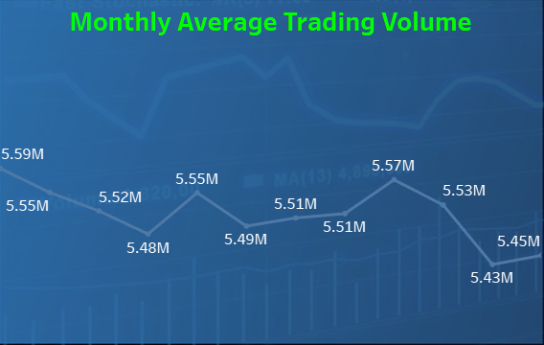
5.Monthly Average Trading Volume
Observation :- The above Graph shows the monthly average trading volume for Acme Corporation over the past 12 months. As you can see, the trading volume has been relatively stable, with a slight downtrend in recent months.
The highest trading volume was in May 2023, at 5.59 million shares, and the lowest trading volume was in August 2023, at 5.43 million shares.
Conclusion :- This data suggests that there is a steady demand for Acme Corporation shares among investors. The slight downtrend in recent months could be due to a number of factors, such as overall market conditions or specific news about the company. However, the overall trading volume remains relatively high, which is a positive sign for the company.

Slide 8
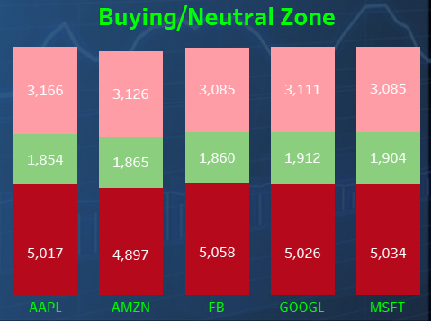
6.Buying / Neutral / Unneutral Zone Signal
Observation :- The Graph shows that Buying / Neutral / un neutral zone signals of the stocks. Were Pink color presents Neutral zone signal. Green color presents Strong Buy zone signal. Red color presents Unneutral Zone Signal. The Highest Neutral Zone Signals are for AAPL stock is 3166. The Highest Strong Buy Signals are for GOOGL stock is 1912. The Highest Unneutral Zone Signals are for FB stock is 5058.
Conclusion :- Overall, the stock chart for Apple Inc. is mixed. The stock is trading in a neutral zone, but there are some bearish signals, such as the MACD crossover and the RSI indicator being in the overbought zone. Investors should carefully monitor the stock chart and other factors before making any investment decisions.

Slide 9
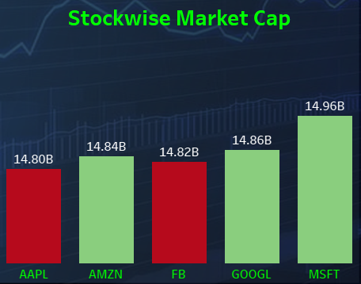
7.Stock Wise Market Capital
Observation :- The KPI shows a Stock Wise Market Capital, Were Column chart represents the Market Capital. Highest Market Capital present with Green color in Column chart which means (AMZN,GOOGL & MSFT) has the highest market capital stocks. Lowest Market Capital present with Red color in Column chart which means (AAPL & FB) has the Lowest Market Capital.
Conclusion :-While investing in these companies can be a good way to gain exposure to these trends, it is important to remember that they are also large and complex businesses. Investors should carefully consider their investment goals and risk tolerance before investing in any company.
Investors who are looking to gain exposure to the stock market should consider investing in technology companies. However, it is important to remember that these companies are also the most cyclical companies in the stock market. This means that their stock prices can be more volatile than the stock prices of companies in other sectors.

Slide 10
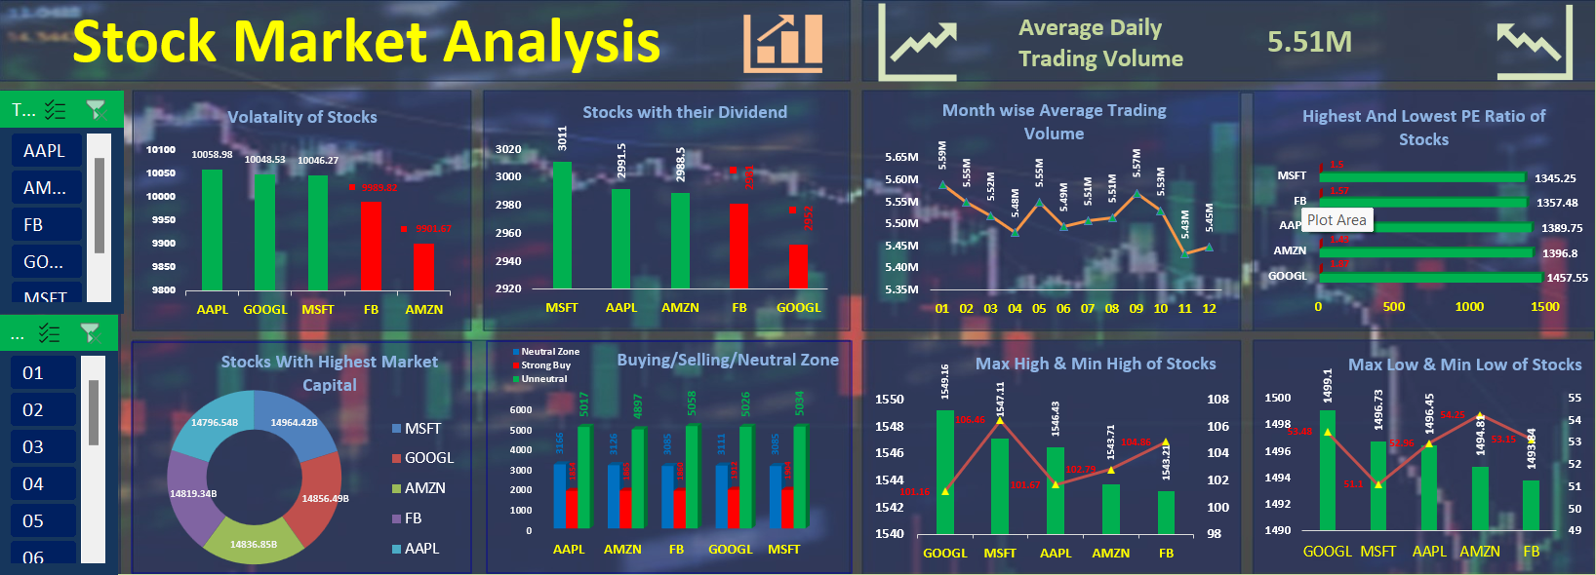
Excel Dashboard

Slide 11
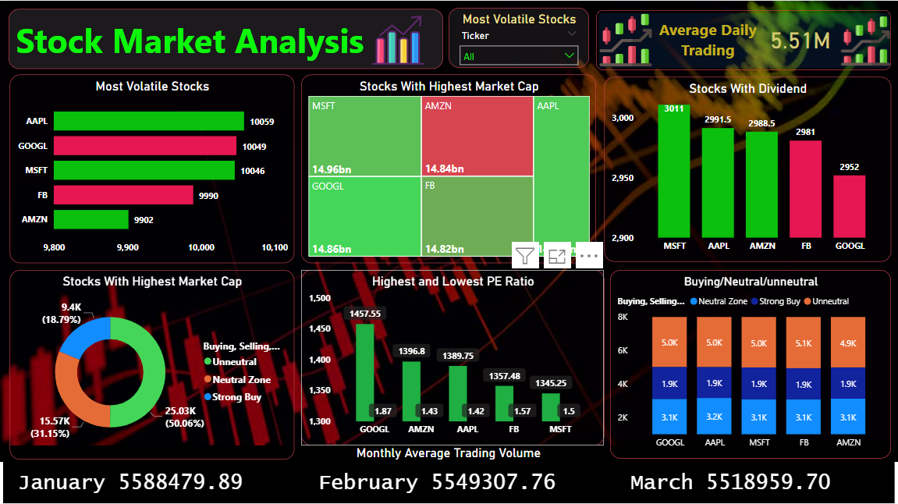
Power bi Dashboard

Slide 12
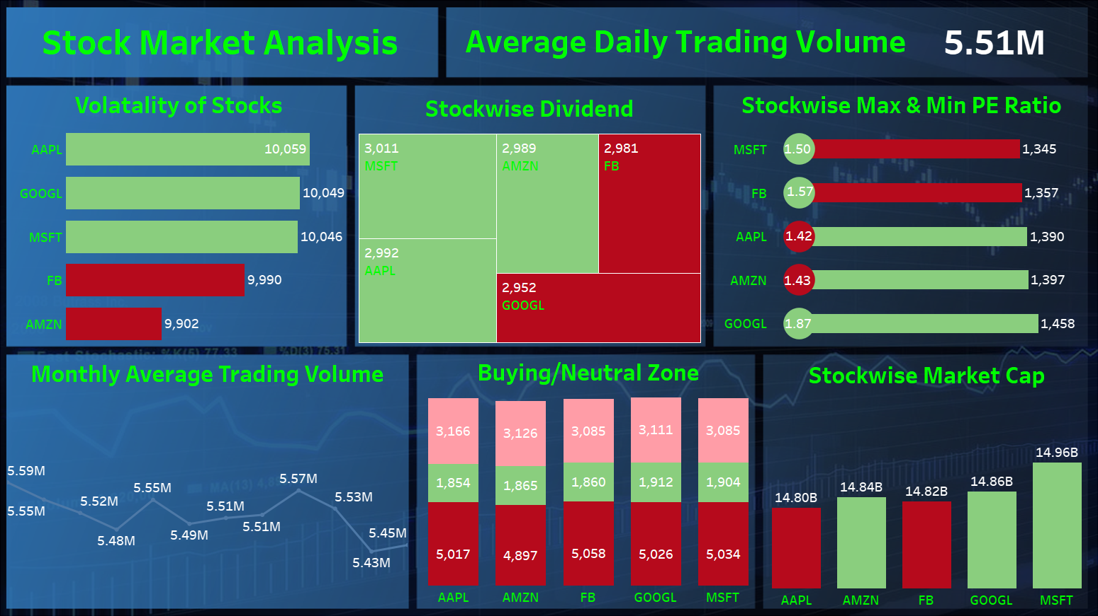
tableau Dashboard

Slide 13
MYSQL Queries
7. Max High & Min High of Stocks
select ticker as Stocks,
round(max(high),2) as Max_of_High,
round(min(high),2) as Min_of_High
from `copy of synthetic_stock_data csv`
group by 1
8. Max Low & Min Low of Stocks
select ticker as Stocks,
round(max(low),2) as Max_of_Low,
round(min(low),2) as Min_of_Low
from `copy of synthetic_stock_data csv`
group by 1
Volatality of Stocks
select ticker AS Stock_name,
round(sum(beta),2) as Volatality
from `copy of synthetic_stock_data csv`
group by 1
order by 2 desc
2. Stocks with their Dividend
select Ticker as Stocks,
round(sum(`Dividend Amount`),2)
as Total_Dividend_Amount
from `copy of synthetic_stock_data csv`
group by 1
order by 2 desc
3. Month wise Average Trading Volume
select Month,
round(avg(volume),2)
as Average_Monthly_Trading
from `copy of synthetic_stock_data csv`
group by 1
order by 1
4. Highest And Lowest PE Ratio of Stocks
select Ticker as Stocks,
round(max(`PE Ratio`),2) as Highest_PE_Ratio,
round(min(`PE Ratio`),2) as Lowest_PE_Ratio
from `copy of synthetic_stock_data csv`
group by 1
order by 2
5. Stocks With Highest Market Capital
select ticker as Stocks,
round(max(`Market Cap`),2) as Highest_Market_Cap
from `copy of synthetic_stock_data csv`
group by 1
order by 2 desc
6.Buying/Neutral/Uneutral Zone
select ticker as Stocks,
Buying_Selling_Neutral_signals,
count(Buying_Selling_Neutral_signals)
as Count_Signals
from `copy of synthetic_stock_data csv`
group by 1,2
order by 1,3 desc

Slide 14
Challanges
Data Quality: Ensuring the accuracy and reliability of the data used for analysis can be a significant challenge. Inaccurate or incomplete data can lead to erroneous conclusions .But Fortunately Data was already sorted.
Market Volatility: Stock markets can be highly volatile, which makes predicting future prices challenging. Unexpected market swings can impact investment strategies.
Regulatory and Ethical Considerations: Compliance with financial regulations and ethical considerations, especially when dealing with sensitive financial data, is a challenge.
Interpreting Signals: Interpreting technical indicators like MACD and RSI accurately can be tricky. False signals can lead to poor investment decisions.
Risk Management: Assessing and managing risks associated with stock market investments is crucial. It's essential to consider diversification, risk tolerance, and hedging strategies.
Changing Market Conditions: Markets are dynamic, and conditions can change rapidly. Staying up-to-date with market news and adapting your analysis accordingly is a constant challenge.
Behavioral Factors: Investor psychology and behavioral biases can influence market movements. Understanding these factors and their impact is complex.

